Slide 1
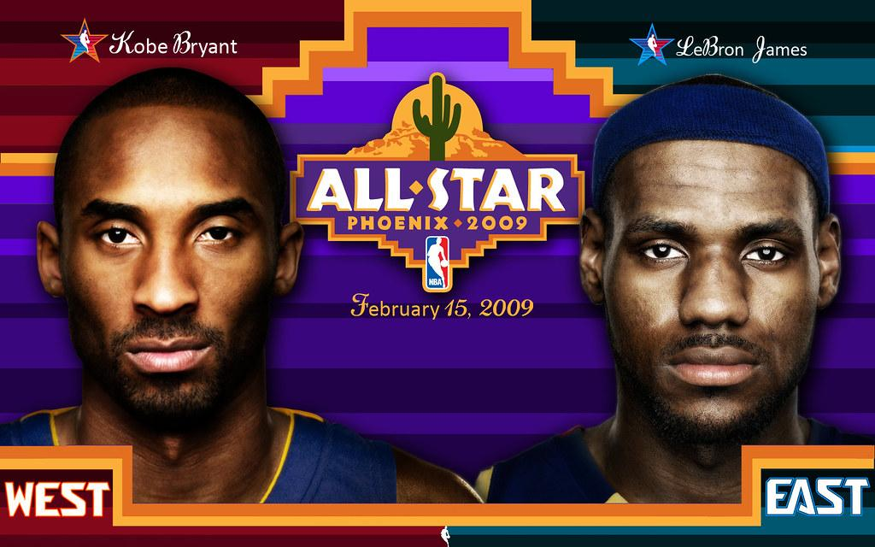
A Tale of Two Basketball Legends
By: Howard Mayorga, Kim Sommer, Ian Castro, & Stephanie Rivas
Notes:
Steph

Slide 2

G.O.A.T. ?
Kobe Bryant and LeBron James are both considered NBA legends. They were both drafted out of high school and went on to win numerous championships for their respective teams. But did one live up to the high expectations placed on him more than the other?
We will examine this question by comparing the statistics from the two players' first twenty years in the league. We want to see whether either player improved from year one to year 18, who improved more and in what areas (i.e., points scored, rebounds, assists) and whose overall stats were more impressive.
Notes:
Steph

Slide 3
Dream Team
Lebron James and Kobe Bryant both played in the same Basketball Olympic Team and won 2 Olympic Gold medals (2008 & 2012)
Notes:
Steph

Slide 4
Champions On and Off-Court
LeBron
I Promise Foundation (20 million per Year is donated to the public school system in Ohio)
The Boys and Girls Club of America in which he donates yearly 2.5 million
Kobe
After School All-Stars
Advocate For Children Fighting Terminal Illness
The Kobe And Vanessa Bryant Family Foundation
Notes:
Steph

Slide 5
Fun Facts
Kobe Bryant has 5 NBA championships and is fourth NBA All-Time Scorer.
His parents named him after a type of steak. The beef is from a species of cattle, Wagyu, raised in the Kobe region of Japan.
Lebron James has 4 NBA championships and is third NBA All-Time Scorer.
All of the LeBron James Family Foundation's work is rolled into the I PROMISE School, an Akron Public School dedicated to those students who are already falling behind and in danger of falling through the cracks.
Notes:
Steph

Slide 6
NBA - Visualization structure
Static folder :
css,
images,
Data and js.
Notes:
Steph

Slide 7


Stats, Stats, Stats… everybody!
API Datasets: https://rapidapi.com/theapiguy/api/free-nba?endpoint=apiendpoint_0c94f219-1d0f-4fc1-8bbb-c5ee6b8327cc
CSV Located next slide
Database Mongo, then SQLite, then back to API
Notes:
Howard

Slide 8

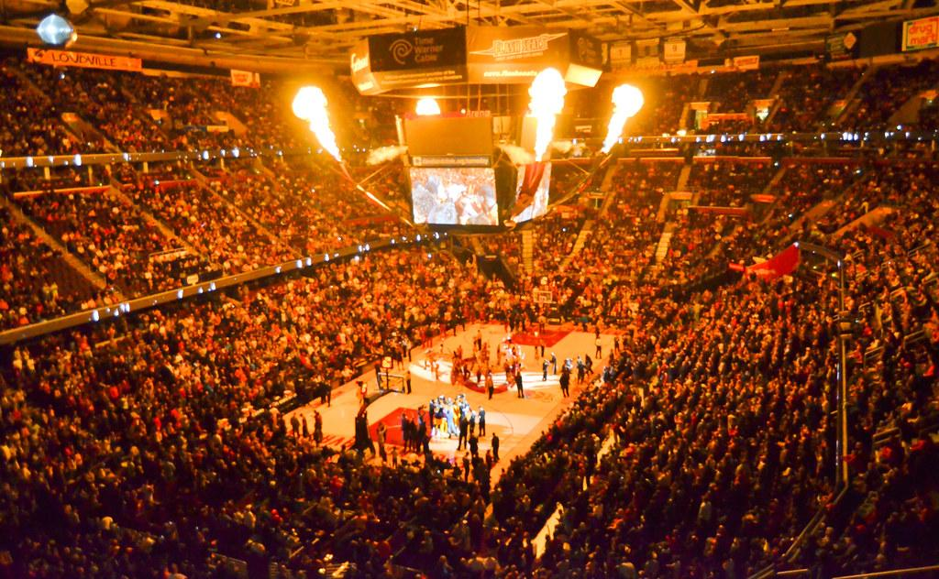
Csv. files
players.csv
Games.csv
Games_details.csv
kobe_data.csv
Lebron_data.csv
Teams_data.csv
teams.csv
Notes:
Howard

Slide 9
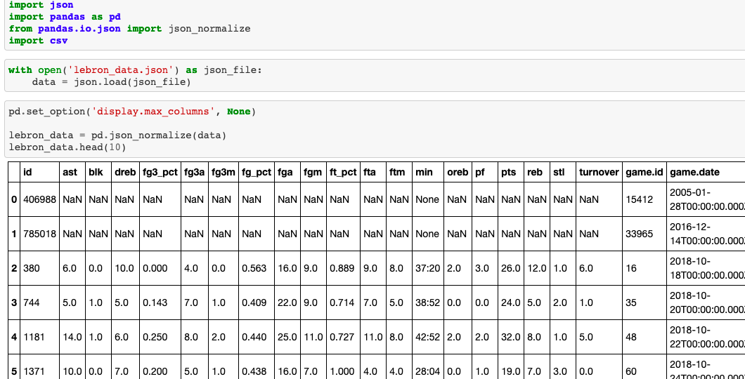

csv + json + pandas = Data!
Time
To
Clean
This
Up!
Notes:
Howard

Slide 10
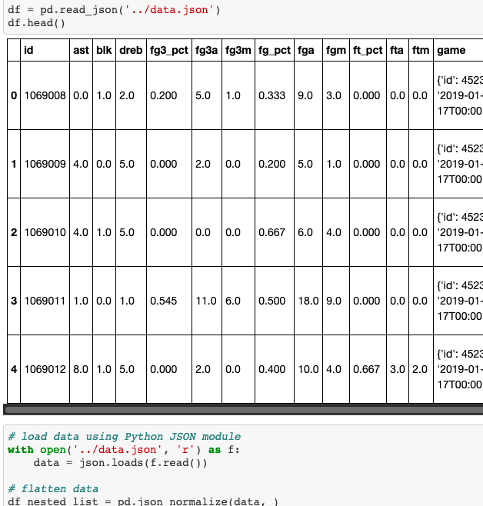
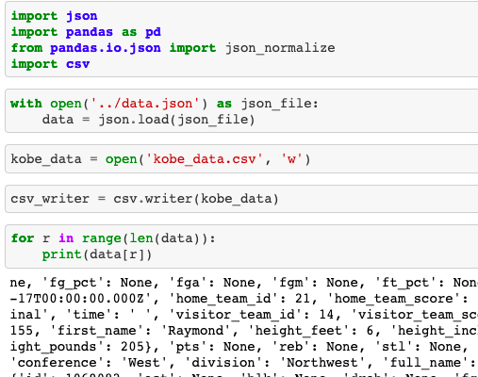
Loads of data
Notes:
Howard

Slide 11

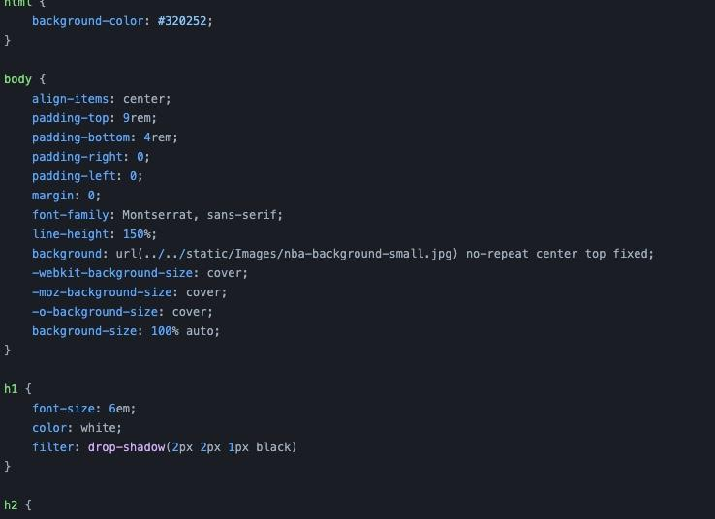
Style.Css
Notes:
Kim

Slide 12
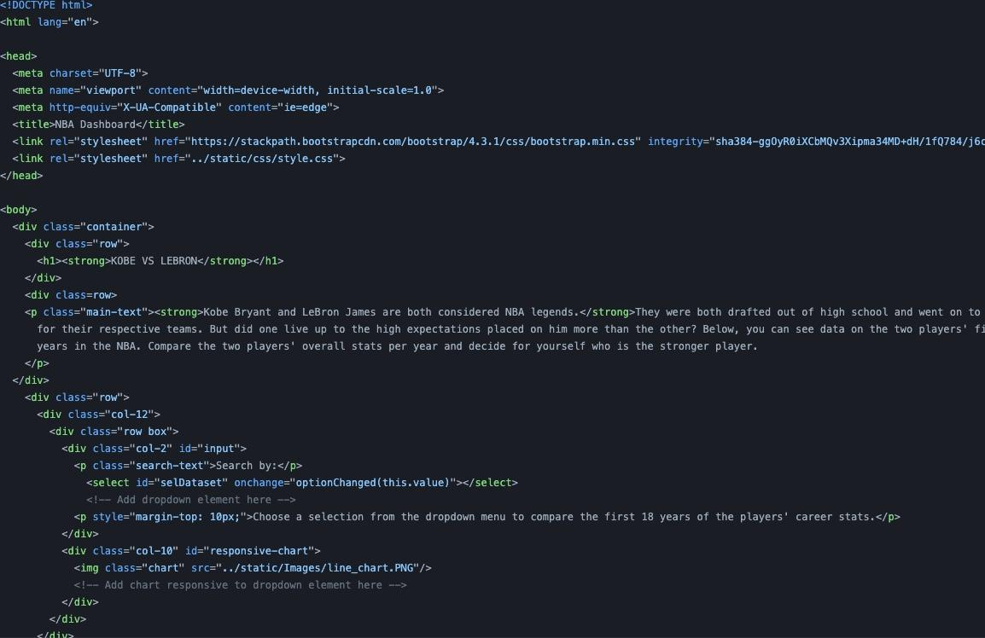
index.html
Notes:
Kim

Slide 13
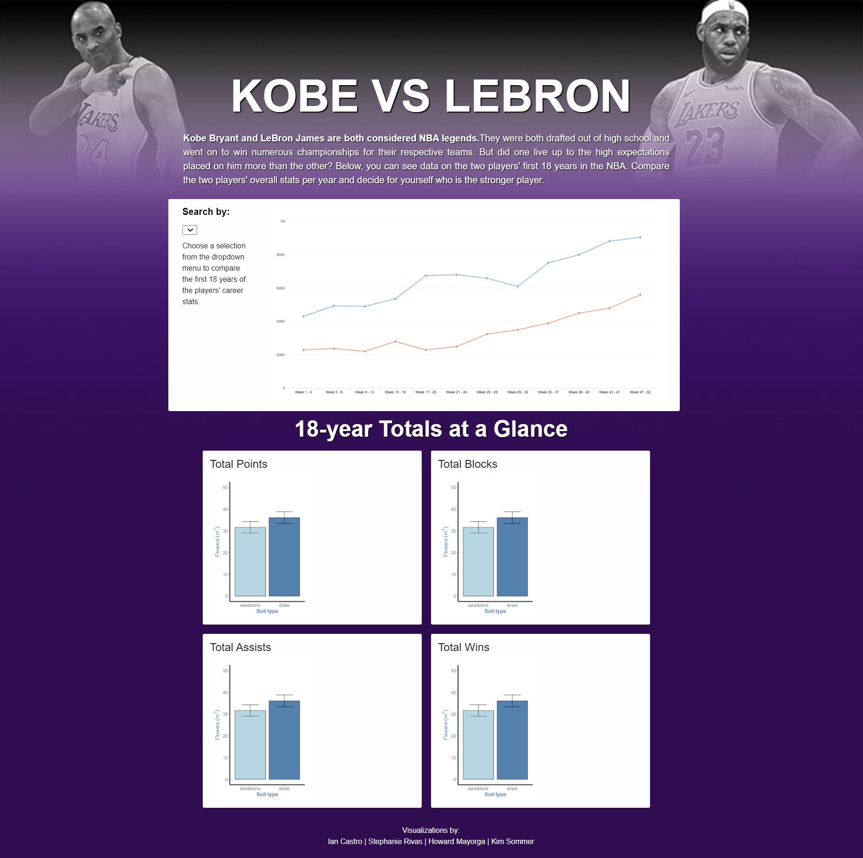
HTML Result

Slide 14
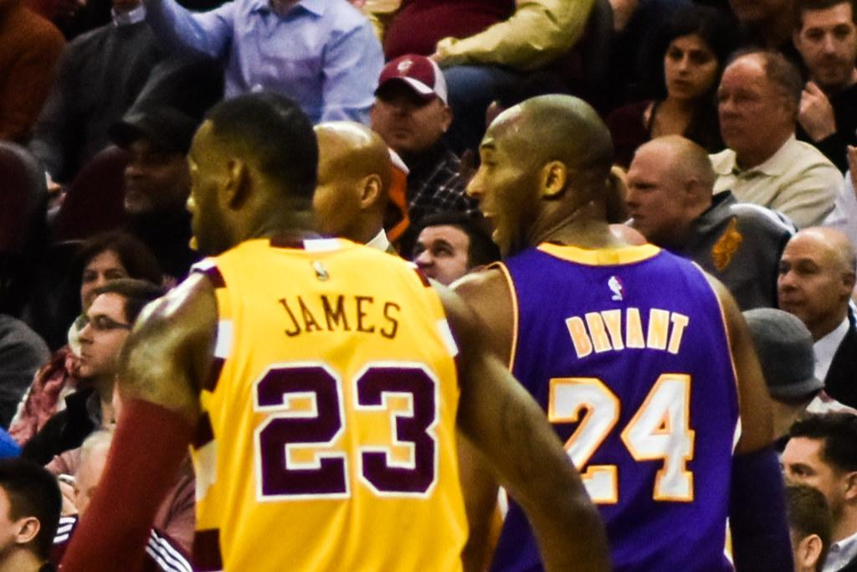
Javascript files
Notes:
Kim

Slide 15
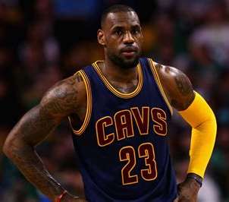
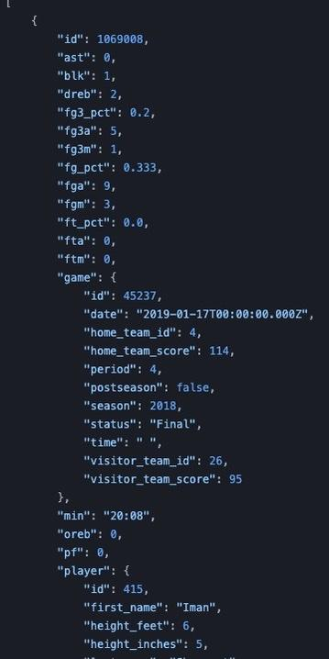
data.json
Notes:
Kim

Slide 16

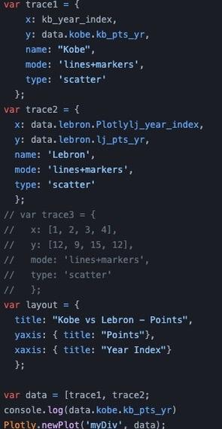
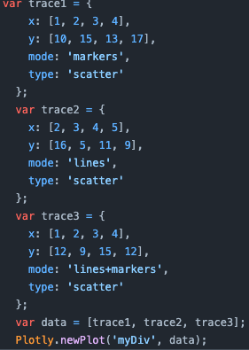
Plot.js
Notes:
Ian

Slide 17
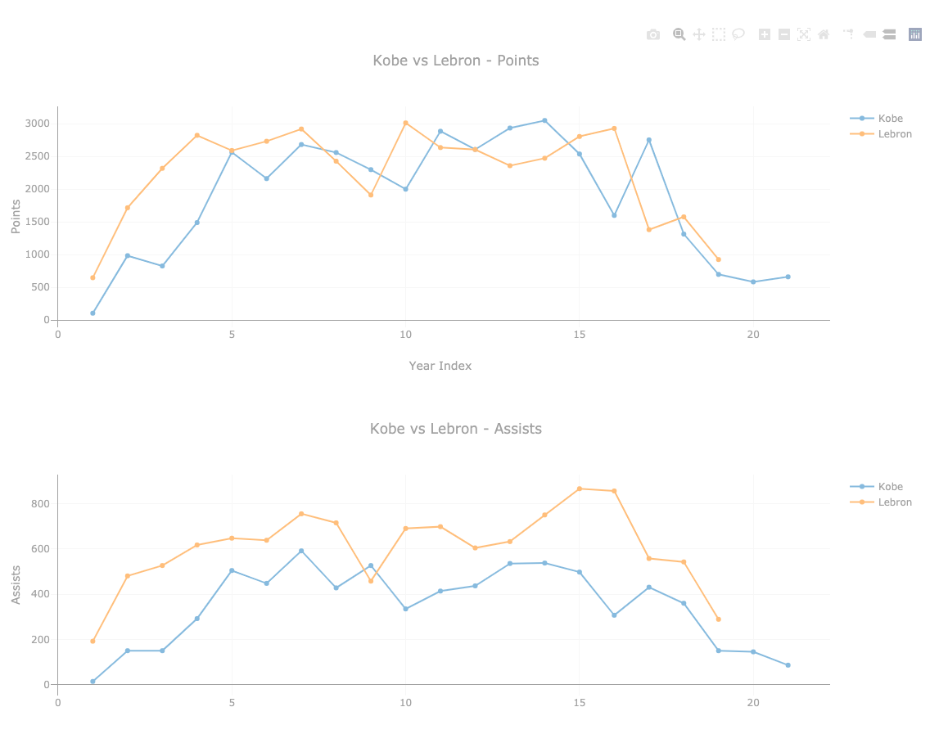
Points x 20 years graph
Notes:
Ian

Slide 18
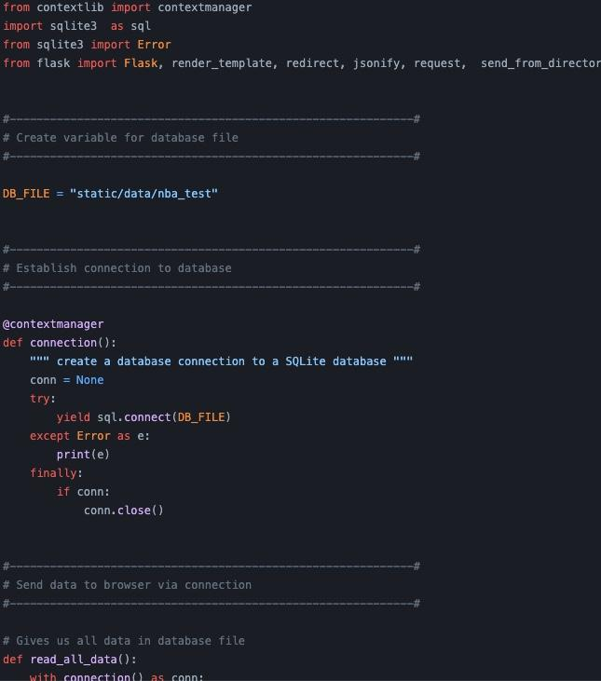
apptest3.py
Notes:
Ian

Slide 19
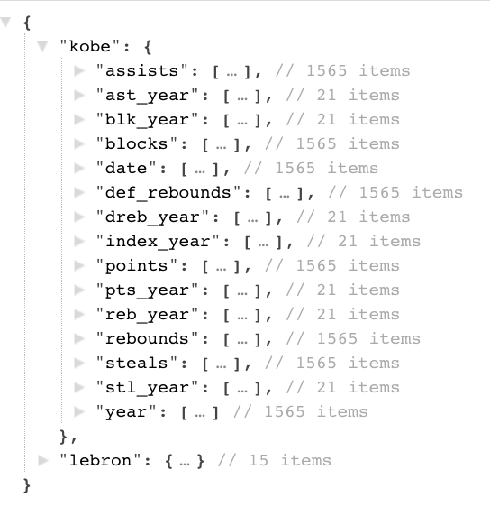
Query Result
Notes:
Ian

Slide 20

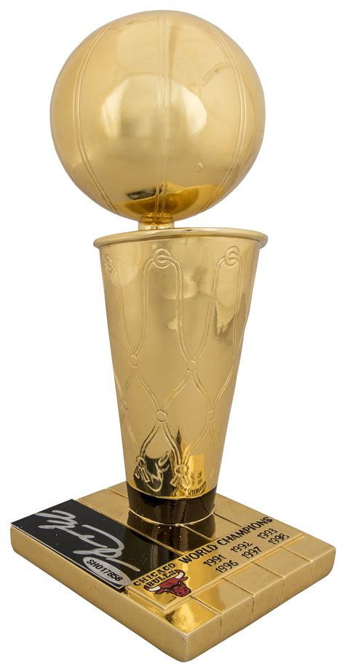
The Winner Is...
Kobe or LeBron??
Notes:
Ian

